Slide 1
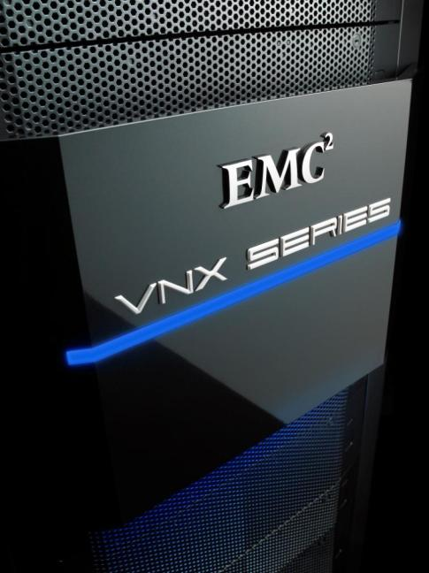
INTRO: VNX & VNXe
Andy Liu
May. 2011
Notes:
Note to Presenter: Present to customers and prospects to provide them with a detailed update of the VNX series. It covers the VNX hardware, supporting the powerful aspect of the simple, efficient, powerful high level VNX message and assumes the customer is familiar with the messaging deck “EMC VNX Series Family Overview” on Powerlink.
Note to Presenter: This presentation does not cover the VNXe platform, although much of the content does apply to VNXe. For a detailed VNXe presentation, please see the VNXe technical presentation on Powerlink.

Slide 2
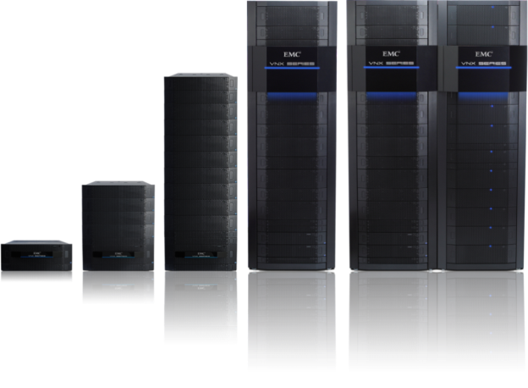
VNX Introduction
Basic Idea of a Unified Storage
VNX Architecture Summary
VNX Component Layout
VNX Components in More Depth
VNX Advanced Features

Slide 3

IT Challenges: Tougher than Ever
Four central themes facing every decision maker today
Overcome flat budgets
Manage escalating complexity
Cope with relentless data growth
Meet increased business demands
Notes:
Whether a shrinking or expanding economy, and whether in mature or emerging markets, key IT challenges remain and traditional approaches to building and managing IT infrastructure no longer make economic sense.
As EMC talks to customers about their IT infrastructure challenges, we find four recurring themes:
Budgets remain flat to slightly up and are not growing nearly fast enough to meet IT demands using traditional approaches.
Companies are struggling to manage increasing complexity and are looking for new tools and methodologies.
Companies see no end in sight to relentless data growth and are looking for ways to keep up.
Finally, fast-changing business models, competitive pressures, and other factors are putting increased demand on IT operations.
It is with these four challenges in mind that EMC designed the guiding principles for its next-generation platforms.

Slide 4
Storage Connectivity Profile is Changing
Increasing emphasis on Ethernet-based connectivity options
EMC offers all major storage connectivity options today
2010-2014
CAGR
NAS + iSCSI + FCoE 13.9%
Fibre Channel SAN 1.3%
Network-attached NAS 5.4%
iSCSI SAN 18.2%
External DAS -8.8%
Fibre Channel over Ethernet 104.6%
Switched SAS 31.9%
Source: IDC, (7/10) and EMC
Notes:
How storage is deployed has been going through a process of change for a number of years now. That change will continue for the coming years. Some interesting things to note from this slide:
Fibre channel revenues are still a strong force in the industry although essentially flat, so the market continues to embrace the technology
The main area of growth is in the Ethernet space:
Note to Presenter: Click to highlight the Ethernet technologies
iSCSI and NAS will continue to grow aggressively as the connectivity option of choice in the sub $75K storage space due to simplicity and the ubiquity of the IP network.
The highest growth rates are seen in the markets for the newer connectivity options, Fibre Channel over Ethernet (FCoE) and Switched Serial Attached SCSI (SAS). Although starting from a small base these technologies will become more relevant (particularly FCoE) starting in 2011.
The loser in the storage connectivity options is the external DAS market. As customers recognize that in order to truly enable the virtualized data center, a fluid and flexible storage connectivity model is required and this space continues to lose market share to the main stream and newer technologies.
The main point to remember is that EMC is the leader or 2nd in all the markets in this chart except the dwindling DAS market. EMC is committed to fully support of all these technologies today or as the market demands on the VNX platform

Slide 5

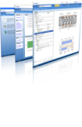


Next Generation Unified Storage
Optimized for today’s virtualized IT
Unisphere™
VNXe3100
VNXe3300
VNX5100
VNX5300
VNX5500
VNX5700
VNX7500
Affordable. Simple. Efficient. Powerful.
Notes:
With these challenges and requirements in mind, EMC is now introducing a new record-breaking unified storage platform—the EMC VNX family.
These hardware and software solutions are simple to provision, highly efficient with lower-capacity requirements, affordable for any budget, and powerful enough to handle the increasing demands of virtual applications.
In fact, the new family delivers the world’s simplest array to manage and the world's highest mid-tier performance.
The VNX family is designed from the ground up for virtual application environments—from simple, money-saving server and storage consolidation for small business, to the next-generation virtual data center applications.
The VNX family is comprised of two series: VNXe series and VNX series.
The VNXe series represents the entry point of the VNX family, and is designed specifically for small-to-medium businesses (SMB), remote offices or branch offices (ROBO), or departmental applications where traditional storage administration skills may not be available.
The VNX series is the next-generation midrange platform. For those of you familiar with EMC’s current CLARiiON and Celerra platforms, the VNX series combines the capabilities of these systems into a single modular unified storage offering.
Note to Presenter: The remainder of this presentation focuses on the VNX Series.
While new, the entire VNX family shares the tradition and builds on years of know-how of the world’s most popular SAN and NAS platforms: CLARiiON and Celerra. Everything EMC has learned about high performance and high reliability is culminating with the VNX Family.
EMC Unisphere provides a common unified management capability for EMC’s VNX family and CLARiiON and Celerra products. And as you will see, Unisphere also provides a way to simplify and automate other common storage management tasks, such as replication and backup reporting.

Slide 6

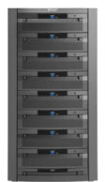
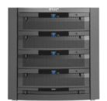


Simple. Efficient. Powerful.
Built for the most demanding virtual environments
#1 SAN Platform
#1 NAS Platform
A new way to think about unified storage
Scales performance and capacity
Self-optimizing
Hyper-efficient
Works on any network
Fully automated
CLARiiON
Celerra
HARDWARE
Notes:
Introducing EMC’s new VNX Series which is built for the most demanding virtual IT environments.
Building on our industry leadership in SAN and NAS storage, VNX offers a better way by combining the best of the industry-leading EMC Celerra and CLARiiON families into a truly unified storage platform. Designed to meet the new demands of midsize and large enterprises, VNX offers a solution that is 3X better.
This means 3X Faster – supporting the 3x the number of transactions and users in virtualized application environments like SQL and Oracle for example.
This means 3X leaner – supporting the ability to get 3X more utilization out of your storage purchases.
This means 3X easier – helping you improve IT staff productivity by reducing the amount of time spent on critical tasks by more than 3X.

Slide 7


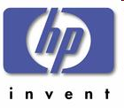


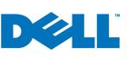


VNX竞争对手一览
Disk Drives | 125 Drives | 250 Drives | 500 Drives | 1000 Drives | 1200 Drives | 1440 Drives
 | CX4-120 NS-120 VNX5300 | CX4-240 VNX5500 | CX4-480 NS-480 VNX5700 | CX4-960 NS-960 VNX7500
 |  | FAS3210 | FAS3240 | FAS3270 | FAS6210 | FAS6240 FAS6280
 | EVA4400 3PAR F200 | EVA6400 P4300 G2 P4500 G2 | EVA8400 3PAR F400 | EVA Cluster P4800 G2
 | DS5020 | DS5100 V7000 | DS5300
 | AMS2100 | AMS2300 | AMS2500
 | PS4000 | PS6000 | PS6500
 | S5300 | S5500 | S5600 | S6800E
 | DX90 | DX410 | DX440
 | 6180 | 6580 7720 | 6780 7420

Slide 8



VNX竞争优势
Vendor
Model | VNX5000 VNX7000 | DS5000 V7000 | P4000G2 EVA | AMS2000 | FAS3000 FAS6000 | S5000 S6000 | ZFS 7400/7700
Unified | √ | x | x | x | √ | x | √
Combo | √ | √ | x | √ | √ | √ | √
6Gb SAS | √ | √ | x | x | √ | x | √
Drives | 125~1000 | 112~480 | 256~1120 96~624 | 120~480 | 240~1440 | 120~480 | 360~576
Cache | 8~240GB | 4~64GB | 4~44GB | 8~32GB | 8~192GB | 4~64GB | 24GB/144GB
10GE | √ | x | √ | x | √ | √ | √
FCoE | √ | x | x | x | √ | x | √
UltraFlex | √ | x | x | x | x | x | x
Cache Mirror | √ | √ | √ | √ | √ | √ | x
Chinese | √ | x | x | x | x | √ | x

Slide 9
VNX Architecture Summary
Notes:
Thank you.

Slide 10


VNX Series
 |  | MODULAR UNIFIED |  |  |  |  | GATEWAY
 |  | VNX5100 | VNX5300 | VNX5500 | VNX5700 | VNX7500 | VG2 | VG8
 | Min. Form Factor | 4U | 7U | 7U-9U | 8U - 11U | 8U – 15U | 2U | 2U
 | Max. Drives | 75 | 125 | 250 | 500 | 1000 | 4000 | 4000
 | Drive types | 3.5” Flash, SAS and NL-SAS and 2.5” 10K SAS |  |  |  |  | BE dependent | BE dependent
FILE | Configurable I/O Slots per X-Blade | n/a | 3 | 4 | 4 | 5 | 3 | 5
 | X-Blades | n/a | 1 or 2 | 1 or 2 or 3 | 2 or 3 or 4 | 2 to 8 | 1 or 2 | 2 to 8
 | Capacity per X-Blade (in TBs) | n/a | 200 | 256
 | System Memory | n/a | 6 GB/blade | 12 GB/blade | 12 GB/blade | 24 GB/blade | 6 GB/blade | 24 GB/blade
 | Protocols | n/a | NFS, CIFS, MPFS, pNFS
BLOCK | Configurable I/O Slots per SP | 0 | 2 | 2 | 5 | 5 | N/A
 | Embedded I/O ports | 4 FC ports, 2 Back-End SAS ports |  |  | 0 | 0 | N/A
 | System Memory | 4 GB /SP | 8 GB/SP | 12 GB/SP | 18 GB/SP | 24 GB/SP | N/A
 | Protocols | FC | FC, iSCSI, FCoE, |  |  |  | N/A
HARDWARE
Notes:
Note to Presenter: Reference slide indicating the physical configuration of the different family members.
An important question you must answer is, “What is the right storage platform that meets my business requirements?”
EMC makes it easy by offering the broadest range of unified storage platforms in the industry. Rate your requirements and choose your solution.
Note to Presenter: Not referenced on this slide but be aware that usable capacities per X-Blade is 256TB for all VNX platforms which allows all systems to be maximally configured as a file only system.

Slide 11
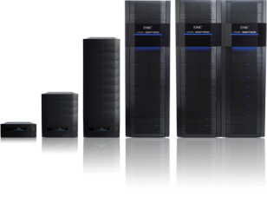
Hardware Architectural Overview
POWERFUL
Optimized for Flash
High performance architecture designed for the Flash drive age
Latest technology
Newest Intel multi-core CPU, large memory; SAS architecture
FLEXIBLE
Optimized packaging
Efficient packaging with dense disk options and built in energy efficiency
Flexible IO modules
FC, FCoE, 1Gb and 10Gb IP; future proofed with plug in architecture for next generation connectivity
AVAILABLE
Storage tiers
Support a mix of ultra-performance, performance, and capacity drives for optimal economics
ECONOMICAL
Advanced failover
Always on, no compromise availability while maintaining application service levels
Modular design
Scale as business needs grow
HARDWARE
Notes:
The VNX platform is architected from the ground up providing the most powerful, flexible and highly available storage solution for the mid-tier market. It provides incredible levels of efficiency to also make it one of the most economical mid-tier storage solutions. It achieves this through a number of technical innovations:
Modular design: Offering a modular design with optimized controllers for the protocols means you can add and scale out the X-Blades independently and without impacting the overall system. Block services are provided by a mature, dedicated and specialized block processor providing native block functionality. File functions are provided by an equally mature, dedicated and specialized file processor providing native file functionality but leveraging the functionality of the block services.
Latest technology, optimized for Flash: VNX leverages the very latest and most powerful hardware components, technologies and protocols in its construction ensuring a class leading core architecture. End to end increases in throughput via SAS disk technology and advanced PCI-E bus architecture improve performance by 2-3x over the prior generation.
Flexible IO Modules: FC, FCoE, 1Gb and 10Gb IP. Future proofed with plug in architecture for next generation connectivity such as Switched SAS
Advanced failover: VNX inherits the enterprise ready robustness of the Celerra and CLARiiON technologies with designed for 5x9’s architecture and advanced availability features.
Storage Tiers: Support a mix of ultra performance, performance and capacity drives for optimal economics. Storage tiers are the foundation for EMC’s innovative FAST Suite, unique in the industry and built to ensure that the storage system achieves the highest utility from the high performance tiers available to it
Optimized packaging: Even with all this high powered technology, EMC has also been careful to ensure the system is as green as possible by introducing new denser drive options, 2.5” drives and using the most energy efficient power supplies possible
You can now see how powerful new VNX innovations help you meet your business needs like never before and give you the competitive edge.

Slide 12





Powerful, Flexible Modular Architecture
More processing power. Self-optimizing pools. Any network.
Unified multi-protocol
Full support for any network
Unified block, file and object support
Share volumes and files
Fully provisioned LUNs
SAN
NAS
CLOUD
BLOCK
iSCSI
FC
FCoE
FILE
CIFS
NFS
pNFS
MPFS
OBJECT
REST
SOAP
X-Blade
X-Blade
Multi-controller scale*
Add X-blades for the right amount of file sharing power
Add storage processors for more storage pool scale
Scales to 96 CPU cores and 4,000 drives
SP
X-Blade
SP
X-Blade
SP
X-Blade
SP
X-Blade
SP
X-Blade
SP
X-Blade
SP
SP
SSD
HDD
Self-optimizing storage pools
Active Data is automatically moved to FLASH for fastest performance
Inactive Data is automatically moved out of FLASH to large disks for lowest capacity cost
Fully Automated. Always on. No management intervention needed. Set-it-and-forget-it.
Lowest transaction cost and lowest capacity cost—simultaneously!
STORAGE POOL
*2 SP’s requires Gateway with multi back end
HARDWARE
Notes:
The VNX series is based on an industry leading architecture that allows you to configure purpose built components that are designed specifically for the different workloads required. For different connectivity options like: SAN (i.e. block connectivity with iSCSI, Fibre Channel or Fibre Channel over Ethernet), NAS (i.e. CIFS, NFS with pNFS or Multi-Path File System) or Cloud ( i.e. with Atmos for REST or SOAP), the VNX platform addresses each with its purposed built modular architecture, simultaneously. The benefits of the modular unified architecture include:
Offering a modular design with optimized controllers for the protocols and workload to be served on. You can add and scale out the X-Blades independently and without impacting the overall system
Both controllers benefit from a central storage pool for LUN provisioning ensuring no stranded unused resources. Frequently accessed data is automatically moved to high-performance Flash drives and infrequently accessed data is moved to high-capacity/low-cost disk drives.
Another advantage of the modular architecture is that EMC has packaged the X-Blades into a NAS gateway model. This gateway supports FC SAN connect to EMC Block storage (Symmetrix, VNX and CLARiiON) and scales with support for up to four storage arrays. So, if you are looking for more storage scale, adding memory, adding drives over and above what is typically supported, add a gateway in front of four VNX7500’s and you can scale up to 8 X-Blades, up to 8 storage processors and up to 4,000 drives.
All the power you need from the VNX series modular architecture.
Note to Presenter: The graphic depicting eight storage processors is based on a configuration that includes a VNX gateway front-ending four VNX Series storage arrays.
Note to Presenter: Click to show the red box, indicating that the following slides (9-40) cover hardware and base software for File and Block components of the VNX solution

Slide 13
Modular Architecture
Designed for optimal flexibility
Proven architecture that extends existing Celerra and CLARiiON investment
Scalable capacity and performance
Dedicated system elements
Flash, SAS and Near-Line for optimal capacity/performance balance
Optimized standalone gateway option
Native NAS and SAN Implementation
Object delivered via integrated solution
Simple, powerful, intuitive consolidated management
Future proofed
Flexible IO options
Plug and play
Object Technology (Atmos VE)
Management
(Single UI, 3rd party management integration)
File Protocol
Native File Services
(NFS, CIFS, FTP, HA IP networking, IP V6 , AVM, deduplication and compression)
Block Protocol
Base Native Block Services
(Storage pooling, automation, security, RAID, SAN, etc.)
Disk Expansion
(Flash, SAS, Near-Line SAS)
HARDWARE
Notes:
Modular design: Offering a modular design with optimized controllers for the protocols means you can add and scale out the X-Blades independently and without impacting the overall system.
Block services are provided by a mature, dedicated and specialized block processor providing native block functionality. An evolution of the industry proven CLARiiON platform, native block implementation ensures optimal performance and leverage tried and trusted value added features for data protection and management.
File functions are provided by an equally mature, dedicated and specialized file processor providing native file functionality. An evolution of the industry proven and leading Celerra NAS platform, the Unified solution provides a powerful native solution for FC, iSCSI, FCoE, NFS, CIFS, pNFS, MPFS and Object support.
The file functionality leverages the core high availability design and software capabilities of the block storage facility and services.

Slide 14


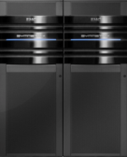


VNX: Modular Unified and Gateway
Implementation models
UNIFIED STORAGE
GATEWAY
Gateway
File
Object
File
Fibre Channel SAN
Block
Object
VNX series
Servers
Symmetrix
VNX series
CLARiiON
Easy to deploy, simple to manage
Scale capacity
Multi protocol
File: NFS (including pNFS), CIFS, MPFS
Block: iSCSI, Fibre Channel, FCoE
Object: REST, SOAP
Leverage existing storage investment
Scale performance and capacity
Shared storage
Add to existing block implementation
File: NFS (including pNFS), CIFS, MPFS
Object: REST, SOAP
HARDWARE
Notes:
EMC offers two types of storage implementation options in the VNX series:
VNX unified storage platforms support the NAS protocols (CIFS for Windows and NFS for UNIX/Linux, including pNFS that is part of NFS v4.1), patented Multi-Path File System (MPFS) as well native block protocols (iSCSI and Fiber Channel) – all included at no additional charge. In addition, Object storage (the REST and SOAP protocols) are available as a solution offering leveraging Atmos VE connected to single or multiple VNX systems (via FC, iSCSi or NFS). VNX unified storage platforms are the right choice when you are looking for an easy to deploy integrated platform with advanced functionality that is flexible and scalable.
VNX Series gateway platforms are NAS heads, only. These platforms access external storage such as block based VNX, CLARiiON, Symmetrix, or combinations of these platforms for optimal performance or TCO. VNX gateways allow the back-end storage to be pooled among the NAS, MPFS and FC/iSCSI SAN, which improves storage usage and consolidates management. Gateways are ideal for environments with existing Fibre Channel/iSCSI SANs.
A VNX gateway is the best choice when you require both performance and capacity scaling. A VNX gateway supports up to four back-end arrays concurrently, delivering increased I/O bandwidth to the front-end X-Blades.

Slide 15



VNX System Architecture
Object:
Atmos VE
Application servers
Exchange servers
Clients
Virtual servers
Oracle servers
SAN
LAN
VNX Unified Storage
FC
iS
FCoE
10Gb
Enet
FC
iS
FCoE
10Gb
Enet
VNX X-Blade
VNX X-Blade
VNX X-Blade
VNX X-Blade
VNX X-Blade
Failover
VNX X-Blade
VNX X-Blade
VNX X-Blade
VNX OE FILE
VNX SP
VNX SP
VNX OE BLOCK
Failover
Power Supply
Power Supply
SPS
SPS
LCC
LCC
Flash drives
Near-Line SAS drives
SAS drives
HARDWARE
Notes:
The servers on the top of the slide reflect the true value of unified storage by enabling servers to connect to VNX via SAN (iSCSI, Fibre Channel or Fiber Channel over Ethernet) and NAS.
This picture illustrates a unified storage product with scalable X-Blades. The VNX 5300 supports up to 2X-Blades, the VNX 5500 supports up to 3 X-Blades, the VNX5700 up to 4 X-Blades and the VNX7500 up to eight. Each system can be configured with at least one X-Blade to be a failover standby blade (the 5300 and 5500 can be ordered with a single X-Blade if File HA is not critical). The 5700 and 7500 can also be configured with more than one standby blade, if desired. This is useful if you’re running two separate applications on different networks, or the environment is very critical and the pool of standby blades provides continued access even in the extremely unlikely event of a double blade failure.
The failover between X-Blades is controlled by the Control Station (not shown). The Control Station is used for configuring the system, and for monitoring the health of the primary blades and initiating failover to the standby blade, if the primary blade fails. The VNX Series supports 1 or 2 control stations for increased availability.
The VNX includes a fully integrated Block processing component, the Storage Processor. The new VNX models offer up to three times the performance of the previous generation CLARiiON CX4.
The back end storage connectivity is via Serial attached SCSI (SAS) which provides up to 6 x the throughput per bus compared to a single FC loop via a 4 lane 6 Gbit connection. The SAS implementation also employs a point to point bus technology for improved performance and resiliency. The internal SP architecture is via PCI-E Gen 2 8x. Memory sizes have increased up to 24GB per SP and leverage DDR 3 technology up to 1330MHz. VNX uses the latest XEON 5600 Processors, the first storage system to do so and leverages the “turbo” functionality to provide increased performance beyond their specification when conditions allow. The CPU and memory in VNX have been physically separated from the I/O complex, which makes servicing and upgrading the systems much easier, and also provides the basis for the VNX UltraFlex technology.
The disk technology used includes Flash and 7.2K 10K and 15K rpm SAS drive types, connecting natively to the SAS interface. The 7200 rpm high capacity drives are also referred to as Near-Line SAS. EMC is moving to SAS in the mid-range space due to comparable performance and economics compared to FC and SATA in addition to a shift in the disk market to SAS.
Note to Presenter: On this slide, SPS = secondary power supply, and LCC = link controller card.
Note to Presenter: On the schematic in the slide, the FLEX IO options are a logical view, in actuality, FC, FCoE and iSCSI Modules are exposed from the SPs and the 10GbE and 1GbE for NAS are exposed from the X-Blades.

Slide 16






VNX Unified Storage
Maximum CPU cores of unified data processing power
OBJECT
Build a single cloud with “N” number of systems
MPFS/pNFS Host
AUTOMATIC SERVER OPTIMIZATION
NAS
SAN
CLOUD
BLOCK
12 cores dedicated to storage pool management and high performance block serving
Storage
Processor
Storage
Processor
X-blade
FILE AND OBJECT
48 cores dedicated to object, networked file system management and data sharing
X-blade
X-blade
X-blade
X-blade
X-blade
X-blade
X-blade
VIRTUALSTORAGE POOL
AUTOMATIC DATA OPTIMIZATION
Flash
(Highest performance)
SAS
(Good performance)
NL-SAS
(Highest capacity)
VNX supports all protocols—today and in the future
HARDWARE
Notes:
The VNX series is based on an industry leading architecture that allows you to configure purpose built components that are designed specifically for the different workloads required. For different connectivity options the VNX platform supports each, concurrently with its purposed built modular architecture.
VNX gives you the choice of low-cost IP or high-throughput Fibre Channel connectivity. VNX delivers both file and block protocols. For higher throughput, Fibre Channel is the growth path for iSCSI (block), and MPFS is the growth path for NAS (files).
VNX lets you start small and scale throughput and capacity.
Multi-protocol support NAS (CIFS and NFS), MPFS, native iSCSI, Fibre Channel and Fiber Channel over Ethernet as well as pNFS all within one unified platform, and at no additional cost, offer cost effective flexibility in deployment options and make VNX an easy purchasing decision.
NAS—File-sharing protocol for Windows and UNIX systems. Typical use cases include: Traditional NAS - CAD/CAM Software engineering, Non-Traditional NAS - Oracle, Vmware
MPFS—Multi-Path File System for improved performance and scalability. See pNFS for use cases
pNFS—Public domain equivalent of MPFS, supported on UNIX and Linux systems in conjunction with NFS V4.1. Support for pNFS for VNX is provided at no additional cost with the advanced protocol license option. Typical use cases for pNFS and MPFS include: Image processing, Bioengineering, Financial Analysis, Oil and gas
iSCSI—Advanced iSCSI implementation using a familiar native CLARiiON Block LUN model with fast failover and full CLARiiON feature support. Similar use cases to Fibre channel, although more typically seen in the commercial and Small to medium business space
Fibre Channel—high-speed networking protocol primarily used in storage area networks providing full native CLARiiON feature set. Typical use cases include: Database/Data warehouse, VMware, High performance needs
Fiber Channel over Ethernet—High speed block protocol over converged (data center) Ethernet transport, is a new protocol appearing in data centers to reduce infrastructure costs by consolidating all storage and data networking needs onto a single Ethernet network. Similar use cases to Fibre Channel.
Cloud: Cloud storage uses open protocols (REST and SOAP) to deliver public and private cloud solutions that leverage the proven back-end storage functionality of VNX. The cloud offering is based upon a solution leveraging Atmos VE running on VMware and using Block (FC or iSCSI) or File (NFS) connections to the VNX platform. Cloud is further supported within Unisphere via Link and Launch. Use cases include content-rich web applications, infrastructure as a service and archiving to the cloud.
Note to Presenter: Further details are found later in this presentation.

Slide 17





Next Generation Data Networking
Converged 10GbE networks are emerging
Trend accelerated by server virtualization
VMware support FCoE, iSCSI, and NAS
EMC now delivers end-to-end Ethernet-based solutions
Converged network adapters
FCoE switches
Native Ethernet/FCoE storage
NIC
HBA
EMC now has expanded portfolio of services
Certification training
Implementation services
Services can be helpful in the following customer use cases
Data center virtualization (cloud)
Unified storage (iSCSI and NAS)
Storage and server consolidation
Converged Network Adapter
IP Network
Converged Network
FC Network
FCoE IO Module
HARDWARE
Notes:
Fibre Channel over Ethernet (FCoE) is an encapsulation of Fibre channel frames over Ethernet networks. This allows Fibre Channel to use 10 Gigabit Ethernet networks while preserving the Fibre Channel protocol. The compelling value of FCoE comes from the simplification and associated cost savings of running a single high performance network infrastructure for all data traffic in the environment, as opposed to independent FC and IP networks. FCoE is dependent on Converged Enhanced Ethernet (CEE) aka lossless Ethernet and implemented in new Converged network switching technology which can be used for FCoE as well as conventional TCP/IP based Ethernet networking. The hosts need to implement new Converged Network Adapters (CNAs) in place of FC HBAs and IP NICs to be able to route both IP based as well as FCOE based host traffic Fibre Channel over Ethernet or “FCoE” combined with 10 Gigabit Ethernet are emerging protocols that are changing the way customers will deploy data center networking in the future. And EMC is at the forefront of this new technology
When it comes to networking, EMC recognizes the importance of maintaining protocol neutrality and has a longstanding history of supporting new technologies. While support for emerging protocols such as FCoE is important, EMC’s approach is to support ALL best-of-breed technologies, including Fibre Channel, iSCSI and NAS as well as FCoE, providing virtual data center customers with extensive choice and proven interoperability.
The VNX supports FCoE concurrently with FC and iSCSI via Flexible IO Modules. VNX supports both Optical and TwinAx copper connectivity for FCoE connected to supported switches (see elab interoperability navigator)
Note to Presenter: VNX does not support direct connections to CEE switches
In addition EMC Global Services will continue to invest a significant amount of time, money, and resources in developing new enhanced services and tools to support EMC’s Converged Networking strategy focused on helping customers deploy advanced networking technologies to enable their journey to the private cloud. EMC’s Global Services, coupled with our extensive Cisco Nexus and Brocade Ethernet product portfolio available through EMC Select, enable EMC to provide a comprehensive network solution for virtual infrastructures.

Slide 18
VNX Component Layout
Notes:
Thank you.

Slide 19

VNX Form Factors
DAE-15x 3.5” & 2.5” drives
(Disk Array Enclosure)
3U
Drives
Add DAEs up to the maximum capacity allowed
Can mix drive types in the same DAE (e.g. 7.2K rpm + 15K rpm
Can mix different DAES in a system (e.g. 15 drives and 25 drives DAEs)
DAE-15x 3.5” & 2.5” drives
(Disk Array Enclosure)
3U
DAE-25x 2.5” drives
(Disk Array Enclosure)
2U
DAE-15x 3.5” & 2.5” drives
(Disk Array Enclosure)
3U
DAE-25x 2.5” drives
(Disk Array Enclosure)
2U
DAE-25x 2.5” drives
(Disk Array Enclosure)
2U
DAE-25x 2.5” drives
(Disk Array Enclosure)
2U
DAE-25x 2.5” drives
(Disk Array Enclosure)
2U
DAE-25x 2.5” drives
(Disk Array Enclosure)
2U
DME
(Data Mover Enclosure)
2U
DME
(Data Mover Enclosure)
2U
File Only or Unified Base*
Need block hardware + file hardware
CS (Control Station) 1 U
CS (Control Station) 1 U
DAE-25
(Disk Array Enclosure)
2U
Block Only Base
DAE = drives only
DPE = storage processors + drives
SPE = storage processors
DPE
(Disk Processor Enclosure)
3U
DPE
(Disk Processor Enclosure)
3U
SPE (C500, C1000)
(Storage Processor Enclosure)
2U
SPS (Standby PS)
1 U
Filler
SPS (Standby PS)
1 U
SPS (Standby PS)
1 U
SPS (Standby PS)
1 U
SPS (Standby PS)
1 U
VNX5100
VNX5300 and VNX5500
VNX5700 and VNX7500
* File and Unified options not available on 5100
HARDWARE
Notes:
The VNX series ships as a block only, file only or Unified file and block system. The file only and Unified systems ship with all the hardware indicated in the diagrams in the slide.
The block-only VNX5300 and VNX5500 comprises only the disk processor enclosure, Standby Power Supply (SPS), and drives (and potentially disk array enclosures depending on the capacity required). If the customer desires (and this is recommended), 4U of rack space (EMC-supplied rack only) and two Fibre Channel ports per storage processor will be reserved for a future upgrade to unified.
A block-only VNX5700 and VNX7500 comprises only the storage processor enclosure, Standby Power Supply, vault disk array enclosure, expansion disk array enclosures, and drives. If the customer desires (and this is recommended), 6U of rack space (EMC-supplied rack only) will be reserved for a subsequent upgrade to unified. There are no Fibre Channel ports to reserve for VNX5700 and VNX7500 as Fibre Channel UltraFlex I/O modules will be added upon performing the upgrade to add file components, although a slot will be reserved so a 4 port FC module can be added at the time of upgrade.
Note: No file hardware is shipped with the VNX5100 as it does not support NAS or iSCSI. Also, space need not be reserved in customer-provided racks for a future upgrade to unified.
The VNX5100, VNX5300, and VNX5500 use disk processor enclosure (DPE) which hold 15 or 25 drives in the block controller for reduced cabinet footprint and reduced cabling. The VNX series DPE includes eight built-in ports of 8 Gb/s Fibre Channel host I/O and two 6 Gb/s SAS back-end buses (2 ports per SP)
SAS and NL-SAS drives are supported, and while optional, EMC maintains the recommendation that large capacity (NL-SAS drives) be configured with RAID 6 to protect against the longer rebuild times associated with these drive types.
VNX supports 2U 25 2.5” drive DAE and DPE for increased density and energy efficiency as well as 3U 15 drive 3.5” DAEs and DPEs
Capacities per X-Blade for all VNX series models is increased to 256 TB (besides the VNX5300, which can only physically support up to 200 Useable TB.)

Slide 20

VNX Unified Storage Components
Architecture and packaging
File implementation: X-Blade enclosure
VNX operating Environment for File
From 2 to 8 blades supported with configurable failover options
Flexible IO connectivity options:
Block implementation: storage or data processor enclosure*
VNX operating environment for block
Dual active storage processors
Automatic failover
Flexible IO connectivity options:
Standby power supplies (battery backup)
Control stations (1 or 2)
Disk array enclosures
Upgradeable to add Fibre Channel ports and/or native 1 or 10 Gigabit Ethernet iSCSI
15x 3.5” & 2.5”
Disk Array Enclosure

SAN
25x 2.5” Disk Array Enclosure

Start with FC or iSCSI or NAS
Add other protocols seamlessly, as needed
25x 2.5”Disk Array Enclosure
Data Mover Enclosure
(X-Blade enclosure)
Œ

Flexible IO options:
4-port 8Gb FC, 4 port 6Gb SAS, 2 port 10GbE, 4 port Copper 1GbE, 2 Port 10Gb FCoE
Control Station
Disk Array Enclosure
DPE
(Disk Processor Enclosure)
3U

Disk Processor Enclosure/Storage Processor Enclosure
Standby Power Supply
Ž
* DPE contains disks, SPE does not contain disks
HARDWARE
Notes:
The basic design principle for the VNX Series storage platform is to use next generation hardware for the VNX for File (X-Blade) front end and the VNX for block hardware for the storage-processor back end. The control flow is handled by the SP in block only systems and the Control Station in File Enabled systems.
The X-Blade Enclosure contains the file X-Blades. To clients on the network, a VNX for File looks like any other file server. The X-Blades feature EMC’s VNX OE for File system software, which is optimized for file I/O.
For the X-Blades, there are four UltraFlex I/O module options: Four ports x 1 Gb BaseT; Two ports x 1 Gb BaseT + two ports 1 Gigabit Ethernet optical; Two ports x 10 Gigabit Ethernet optical or Two ports x 10 Gigabit Ethernet Twinax
X-Blade types cannot be mixed in the same system. Each X-Blade is configured with one 4-port 8Gb Fibre Channel I/O module for storage array connectivity and tape connectivity (for NDMP).
The Control Station is used to configure, manage, and upgrade the X-Blades, as well as to manage X-Blade failover.
Two Blade VNX is typically configured as primary/standby—that is, with one X-Blade designated to act as standby. The standby waits, fully booted, for the primary X-Blade to fail. Because of this wait, there is no performance degradation on failover. In the event that the primary X-Blade fails, the standby X-Blade will take the load from the primary, then present itself to the network as the failed X-Blade. In the other two-blade option, called primary/primary, both X-Blades are active. Should an X-Blade fail, it will quickly reboot and present itself back to the network.
Multi blade systems are typically configured with N+1 or N+M advanced failover (where n is the active X-Blade and M is a pool of standby X-Blades) where one X-Blade is configured as standby or where a number of X-Blades are configured as a pool of failover X-Blades for the active blades.
Note to Presenter: Primary/primary (supported on VNX5300) is not recommended for critical data. During the reboot, the data will be inaccessible. If the X-Blade fails due to a hardware problem, the data will be inaccessible until it is replaced.
The Data Processor Enclosure (DPE) or Storage Processor Enclosure (SPE) uses dual active Storage Processors (SPs) for disk I/O. These processors run the VNX OE for Block — a proven, robust RAID implementation. The SPE supports automatic failover should one of the SPs fail. Each SP supports UltraFlex I/O Modules that can be populated with Four ports x 8 Gb Fibre Channel; Four ports x 1 Gb BaseT (copper) iSCSI; Two ports x 10 Gigabit Ethernet optical iSCSI; Two ports x 10 Gigabit Ethernet Twinax iSCSI; Two ports Fibre Channel over Ethernet
.The disk array enclosures are either 15x3.5”disk shelves (Flash, SAS and NL-SAS) or 25x2.5” disk shelves for disk capacity (SAS).
The SPE/DPE can be configured to also support Fibre Channel hosts, Native iSCSI hosts or FCoE hosts. Fibre Channel hosts can attach directly by adding Fibre Channel I/O modules (four ports per Fibre Channel I/O module) or with a standard Fibre Channel switch. Native iSCSI hosts can attach through switches to either 1 or 10 Gigabit Ethernet ports. Fibre Channel over ethernet can attach through supported CEE switches

Slide 21
Simplified Upgradeability to Unified
Unified is the default configuration
Block only:
SPE/DPE
“File Ready Option”
Reserve 4U-6U Rack Space
Reserve FC ports or I/O Slot
Upgrade to Unified
Add Data Movers (1 to 8)
Add Control Stations (1 or 2)
Add SFP or FC I/O module
Add Unisphere File Enabler
File only:
Same HW as Unified
Add FE SLIC to array
Add Unisphere block enabler
15x 3.5” & 2.5” drives
Disk
25x 2.5” drives
Data Movers
File Only
or Unified
Control Stations
Storage Processors
(SPE/DPE)
Block Only
Power Supply
HARDWARE
Notes:
A block-only-to-unified upgrade will require the addition of an X-Blade enclosure with one or two X-Blades, one or two Control Stations and the Unisphere Block-to-Unified license.
For the VNX5300 and VNX5500, the X-Blades will connect through Fibre Channel to the built-in Fibre Channel ports.
For the VNX5700 and VNX7500, a pair of Fibre Channel UltraFlex I/O modules must be installed in the array chassis (i.e., the storage processor enclosure) to permit connection to up to four X-Blades. These ports can be reserved in block only configurations to allow simple upgrades from block to unified.
If VNX7500 is to be configured with five to eight X-Blades, a second pair of Fibre Channel UltraFlex I/O modules must be installed in the storage processor enclosure.
For the VNX5300, VNX5500, VNX5700, and VNX7500 platforms, the Unisphere Block-to-Unified license must be purchased and installed.
File-only-to-unified upgrades require the installation of the Unisphere File-to-Unified license, as well as at least one pair of host connectivity UltraFlex I/O modules (e.g., Fibre Channel, 1 Gigabit Ethernet iSCSI, 10 Gigabit Ethernet iSCSI, and/or Fibre Channel over Ethernet).
Note that the upgrade to unified may also require additional storage capacity in the form of added disk array enclosures and disks. The VNX5100, however, cannot be upgraded to unified as it supports Fibre Channel only. Block-to-unified and file-to-unified upgrades requiring services engagements are expected to GA in Q2/Q3 2011.
In addition to Unified upgrades, VNX also supports the addition of conventional drive/disk array enclosure (2.5” and 3.5”), X-Blade/Data Mover Enclosure, X-Blade and array UltraFlex I/O modules, and additional software

Slide 22
Simplified Upgradeability to Unified
Unified is the default configuration
Block only:
SPE/DPE
“File Ready Option”
Reserve 4U-6U Rack Space
Reserve FC ports or I/O Slot
Upgrade to Unified
Add Data Movers (1 to 8)
Add Control Stations (1 or 2)
Add SFP or FC I/O module
Add Unisphere File Enabler
File only:
Same HW as Unified
Add FE SLIC to array
Add Unisphere block enabler
15x 3.5” & 2.5” drives
Disk
25x 2.5” drives
Data Movers
File Only
or Unified
Control Stations
Storage Processors
(SPE/DPE)
Block Only
Power Supply
HARDWARE
Notes:
A block-only-to-unified upgrade will require the addition of an X-Blade enclosure with one or two X-Blades, one or two Control Stations and the Unisphere Block-to-Unified license.
For the VNX5300 and VNX5500, the X-Blades will connect through Fibre Channel to the built-in Fibre Channel ports.
For the VNX5700 and VNX7500, a pair of Fibre Channel UltraFlex I/O modules must be installed in the array chassis (i.e., the storage processor enclosure) to permit connection to up to four X-Blades. These ports can be reserved in block only configurations to allow simple upgrades from block to unified.
If VNX7500 is to be configured with five to eight X-Blades, a second pair of Fibre Channel UltraFlex I/O modules must be installed in the storage processor enclosure.
Also, for the VNX5300 the file connectivity license is included with the Unisphere Block-to-Unified license. For the VNX5500, VNX5700, and VNX7500 platforms, a file connectivity license and Unisphere Block-to-Unified license must be purchased and installed.
File-only-to-unified upgrades require the installation of the block connectivity license, the Unisphere File-to-Unified license, as well as at least one pair of host connectivity UltraFlex I/O modules (e.g., Fibre Channel, 1 Gigabit Ethernet iSCSI, 10 Gigabit Ethernet iSCSI, and/or Fibre Channel over Ethernet).
Note that the upgrade to unified may also require additional storage capacity in the form of added disk array enclosures and disks. The VNX5100, however, cannot be upgraded to unified as it supports Fibre Channel only. Block-to-unified and file-to-unified upgrades requiring services engagements are expected to GA in Q2/Q3 2011.
In addition to Unified upgrades, VNX also supports the addition of conventional drive/disk array enclosure (2.5” and 3.5”), X-Blade/Data Mover Enclosure, X-Blade and array UltraFlex I/O modules, and additional software

Slide 23
VNX Components
in More Depth
Notes:
Thank you.

Slide 24
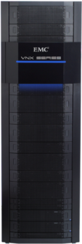


VNX Storage Processor
Dedicated processing for block services
Administrator
Block services
Flexible RAID options (10,3,5,6) provide optimal performance AND protection
RAID Groups and Virtual Pools
Administration/management
Through storage processor Ethernet ports
Aggregated to single file/block view in Unisphere
Single point of management/control
High availability Active/Active controller failover option
Connects to Hosts via FC, FCoE, iSCSI for flexibility of connection
Connects to storage via 4 lane 6Gbit SAS for up to 24Gb/SAS bus (6x prior generation)
Unisphere
Private
Network
Storage Processors
FC/iSCSI
SAN
VNX
HARDWARE
Notes:
Active/Active Controller Design:
The VNX platform storage processors by design operate in Active/Active mode. Active-Active implies that both controllers are active/on-line and receiving host I/O simultaneously for the backend storage. VNX OE for Block runs on the SPs and has a LUN Ownership model where a LUN is either owned by SP-A or SP-B and both SP’s serve I/O’s to its set of LUNs.
These systems also support Active/Active access to the same LUN from both SP’s simultaneously. This is done via ALUA (Asymmetric LUN Access) Failover Mode. This allows host that is ALUA aware (most modern O/S’s are) to send I/O for a LUN via either SP.
For Example: A LUN 200 may be owned by SP-A but host can send I/O for this LUN via both SP-A and SP-B. SP-B will internally and transparently re-direct I/O over high speed inter-SP interconnect to the SP-A and service the same.
ALUA implementation essentially gives host Active-Active Access to backend storage via either controller/SP. SP’s internally optimize the i/o by either internal redirection or by LUN transfer to provide best response time and throughput to the host. The VNX Platform has ALUA as the default Failover mode, allowing MPIO ready O/S’s to benefit from this Active-Active access out of the box with no special configuration.
Automatic Load Balancing:
The VNX OE for block software has been designed to ensure the I/O is well balanced between the two SP’s.
Firstly, at the time of provisioning, the odd number LUNS are owned by one SP and even number LUNs are owned by the other, this results in LUNs being evenly distributed between the two SP’s.
And in the event of a failover, LUNS would trespass over to the alternate path/SP. This is where EMC PowerPath comes in and it restores the ‘default’ path once the error condition is recovered. This brings the LUNs again in balanced state between the SPs.

Slide 25


Flexible Storage Tiers
Optimize TCO with tiered service levels
SAS back-end connect for performance and reliability
Up to 24Gb (4x6 Gb) per SAS bus
Point-to-point, robust interconnect
Flash (SSD) options
Highest performing drives
3.5” – 100 GB, 200 GB
~3,000 IOs per second
SAS (HDD) options
3.5” drives (195 drives/ rack)
300 GB and 600 GB
10K and 15K RPM
~ 140 (10K) to ~ 180 (15K) IOs per second
2.5” Drives (500 drives/ rack)
300 GB and 600 GB
10K RPM
Near-line SAS (HDD) options
3.5” drives (195 drives/ rack)
2 TB
7.2K RPM
˜ 90 IOs per second
AUTOMATIC DATA OPTIMIZATION
VIRTUALSTORAGE POOL
Flash
SAS
(10K /15K rpm)
Near-line SAS
(7.2K rpm)
Highest performance
Good performance
Highest capacity
HARDWARE
Notes:
The VNX implements SAS disk connectivity across the series. This provides for improved throughput 6Gbits x 4 lanes (24Gb) per SAS bus as well as improved Reliability and Robustness due to:
Point to point topology
Fast Fault Isolation and identification of fault backend components
4 lane SAS cables offer inherently robust interconnect
All components will continue to run even with 3 out of 4 lanes damaged/nonfunctional
VNX supports 2 disk formats, 3.5” and 2.5”. Initially the 2.5” drives supported are the 10K rpm SAS drives and are supported in a new 2U DAE that carries up to 25 drives, with up to 500 drives per rack. In the future the 2U DAE will support additional SAS options. Also denser 3.5” drive DAE options will be released in the future and will require a new dense rack, not available at initial release.
2.5” and 3.5” drives are supported in the 3U DAE (2.5” drives in 3.5” carriers) and all drive types are supported in the same DAEs eg the 3U DAE can be configured with Flash, 10K and 15K SAS or 7.2K SAS and combinations. 3.5” drives cannot fit in the 2U DAE
2.5” drive technology provides significant density and power improvements over the 3.5” technology eg. a CX480 with 480 3.5” drives consumes 3 racks and 100U. A VNX5700 with 500 2.5” drives consumes 2racks and 44U and uses 53% less power and cooling.
Note to Presenter: 7.2K rpm NL-SAS drives are not supported as Vault drives for any of the VNX series. In addition there is a discretionary recommendation that any drive greater than 1TB be configured with Raid-6 to provide additional protection in situations where a long rebuild might occur.
All the mixed drive combinations shown on the slide are supported in any of the VNX series systems. System TCO and performance can be concurrently optimized when implementing the FAST Software Suite which ensures the highest activity data is placed on the fastest possible disks (Flash) and the dormant data is dynamically moved to the capacity drives (NL-SAS).

Slide 26
VG2 and VG8 Gateway Components
Architecture and packaging
Ž
File implementation: X-Blade enclosure
VNX operating environment for file
Configurable blade options 2 to 8
Primary/standby with automatic failover
Primary/primary with quick reboots for entry platforms
N+M advanced failover for four+ blade systems
Flexible IO connectivity options:
Four x 10/100/1000 copper Ethernet ports
Two x Gigabit Ethernet optical plus two x 10/100/1000 copper ports
Two x 10 Gigabit Ethernet optical ports
Control stations (one or two)
Configuration and management
Reliability, availability, serviceability
Symmetrix, VNX, or CLARiiON storage
SAN
Symmetrix
VNX series
CLARiiON
DME
(Data Mover Enclosure)
2U
Œ
CS (Control Station) 1 U

HARDWARE
Notes:
The high-end VNX gateway system (NAS head only) is called the VG2 and VG8, which connects to the standard VNX for block system as well as CLARiiON or Symmetrix back-end storage through a Fibre Channel SAN.
The basic design principle of the VG8 is—through X-Blades and control sations—to separate data flow from control flow, which is handled by the Control Station. VG8 supports up to eight X-Blades with advanced failover (N+1 or N+M) under a single point of management and control—all the benefits of a true cluster, without the management aggravation.
Each VG8 X-Blade uses the UltraFlex I/O module concept, allowing up to five I/O modules per X-Blade. The I/O module options are four 10/100/1000 Ethernet (copper) ports, two 10/100/1000 Ethernet (copper) ports plus two Gigabit Ethernet optical ports, or two 10 Gigabit Ethernet ports. Each X-Blade is configured with one 4-port Fibre Channel I/O module for storage array connectivity and tape connectivity (for NDMP). The Fibre Channel module can be either 4 Gb/s or 8 Gb/s Fibre Channel.
Note to Presenter: X-Blade configuration types cannot be mixed in a VG8 system, although the FLEX IO Modules can be added in any combinations (the first slot must contain an 4-port FC Module) allowing X-Blade configurations with combinations of all possible connectivity types; copper Ethernet, copper plus optical Ethernet and optical 10 Gigabit Ethernet.
The X-Blades feature EMC’s VNX OE for File embedded system software, which is optimized for file I/O. The Control Station is used to configure, manage, upgrade, and failover the X-Blades, as well as to manage X-Blade failover.
The VG2 offers a single blade with fast reboot or dual blade with N+1 failover and the VG8 offers N+1 and N+M advanced failover. N+M advanced failover can be thought of as Blade-RAID. Typical configurations would implement N+1 (RAID 5) with one standby for up to seven primary blades; although for the highest availability, it is possible to configure multiple standby blades that act as a pool (i.e., N+M where M is the pool of failover blades) to cater to multiple concurrent blade failures—for example, six primary plus two standby (RAID 6) or even four primary plus four standby (RAID 1). The standby blades wait, fully booted, for the primary X-Blade to fail. There is no performance degradation on failover, and the standby X-Blade presents itself to the network as the failed X-Blade.
VNX VG2 and VG8, like all the members of the VNX Series, has the high-availability features you expect from EMC, including dual power supplies, dual fans, full battery backup, and the “call-home” card for remote and predictive diagnostics. The VG2 and VG8 also provides dual Control Stations for Control Station failover as an option.
Note to Presenter: See the “NAS Support Matrix” on Powerlink for the current list of supported back-end storage: http://powerlink.emc.com/km/live1/en_US/Offering_Technical/Interoperability_Matrix/NASSupportMatrix.pdf.

Slide 27


VNX X-Blades
Run the world’s most mature NAS operating system
Up to eight independent file servers contained in a single system
Scale by adding enclosures: 2 X-Blades per X-Blade enclosure
Managed as one, high-performance, high-availability server
Connects data to the network
VNX operating environment for file
No performance impact after failover
Concurrent Network File System (NFS), Common Internet File System (CIFS), File Transfer Protocol file access, MPFS/pNFS
Hot-pluggable
Flexible N-to-M failover options
Continues to operate even if control station fails
No internal disks in the Gateway
Network
X-Blade
X-Blade
X-Blade Enclosure
X-Blade
X-Blade
Control Station
Control Station
VNX series
VNX, Symmetrix
or CLARiiON
HARDWARE
Notes:
Note to Presenter: View in Slide Show mode for animation. This slide shows a gateway system (external storage connect via switch), although the functionality is exactly the same as in the non-Gateway VNX systems except the storage is connected directly to the VNX for file components).
X-Blades are the muscle of VNX for File - they do all the work. Each X-Blade is an independent, autonomous file server that remains unaffected should a problem arise with another X-Blade.
The multiple X-Blades (up to a maximum of eight) are managed as a single physical entity. X-Blades are hot-pluggable and offer N+1 and N+M advanced failover. In addition, X-Blades will continue operation independent of any Control Station halts or restarts.
The X-Blades run a mature EMC operating system called VNX OE for File, which is optimized to move data between the storage (VNX for block components in the case of an integrated VNX system or Symmetrix/CLARiiON for the gateway) and the IP network.

Slide 28


VNX Control Station
Secure management and control for VNX for file
Installation
Administration/management
Through X-Blade and Storage Processor Ethernet ports
Configuration changes
Monitoring and diagnostics
Heartbeat pulse of X-Blade
Monitors and manages X-Blade failover
Enterprise Linux-based (RHEL 5)
Initiates communications with X-Blades for greater security
Single point of management/control
Failover redundancy option
Administrator
Unisphere
Private
Network
Control Station
Control Station
Control Station
VNX series
HARDWARE
Notes:
Note to Presenter: View in Slide Show mode for animation.
The Control Station software provides VNX for File’s controlling system—it runs an EMC value-added version of the Red Hat Enterprise Linux V5 industry-standard UNIX operating system. The Control Station also provides a secure user interface to all file-server components—a single point of management for the whole VNX solution, which can be isolated to a secure, private network.
Control Station software is used to install, manage, and configure the X-Blades; monitor the environmental conditions and performance of all components; and implement the call-home and dial-in support features. The unified user interface used to manage the VNX talks directly to the Control Station when managing file functionality.
Typical administrative functions for File include managing volume and file systems, configuring network interfaces, creating file systems, exporting file systems to clients, performing file-system consistency checks, and extending file systems (both manually and automatically).
Control Station administrative functions are accessible via Unisphere, through a command-line interface on Telnet or secure shell, and via the VNX Startup Assistant and VNX Provisioning Wizard in the VNX installation toolbox.

Slide 29

VNX X-Blade Failover
High availability architecture with no performance impact
No client-performance
impact
Configurable X-Blade failover options
N-to-M, Automatic, manual, none
Failover triggers:
Software panic or hang
Internal network failure
Power failure
Memory error
Non-responsive X-Blade
Failed X-Blade shut down to avoid “split-brain syndrome”
IP, Media Access Control (MAC), and Virtual LAN (VLAN) addresses are transferred
No performance impact after failover
Automatic control station failover
Configuration dependent failover times of ~15 secs to ~100 secs
Network
Control Station
Control Station
Data path transferred
X-Blade
X-Blade
X-Blade
X-Blade
X-Blade
Data remains accessible
VNX series
HARDWARE
Notes:
Note to Presenter: View in Slide Show mode for animation.
When a VNX is configured for File access, one or more X-Blades are designated to act as standby X-Blades. They wait, fully booted, for a primary X-Blade to fail.
In most file serving as well as design and manufacturing environments, customers have found it sufficient to have one failover X-Blade for every three or four active X-Blades. In Financial, Telecommunications, and Internet environments, customers may elect to have a standby X-Blade for each active X-Blade. Failover can be selected to occur automatically, manually (operator intervention required), or never.
Although very rare, failovers can occur because of software issues. Failover can also be triggered by failure of both internal networks, power failure, unrecoverable memory errors, or non-response. However, some customers have run for years without X-Blade failover.
The Control Station monitors X-Blades through a redundant internal network. If an X-Blade has a problem, the first thing the Control Station does is disable that X-Blade. This prevents the “split-brain” phenomenon, in which a processor may be “sick” enough to cause a failover to a unit that tries to take over and writes to the primary’s volume; meanwhile, the sick primary, unaware that it is sick, continues to write to that same volume. When a sick primary and a failover unit write to the same volume, you cannot recover. VNX systems make such situations impossible by separating data flow from control flow.
There is no performance degradation on failover, as the standby X-Blade is waiting, booted, to take the load from the primary. The VNX systems fine granularity makes this possible, and prevents the propagation of faults.
After the active X-Blade is shut down, the Control Station tells the standby X-Blade to get the active X-Blade’s network addresses (MAC [Media Access Control], IP, and VLAN [virtual local area network]). Then the standby X-Blade presents itself to the network as the failed X-Blade. Failover is transparent to UNIX clients, which do not maintain state. They may see a “Server Not Responding” message, but upon re-issuing the NFS request to the same address, they will get the information they want. Windows clients maintain state, so they will see a failover if they issue a CIFS request during a failover. Depending on the Windows application, the client may re-issue the request, need to reboot the application, or reboot the client.
Failover times vary based upon the size of the configuration. A minimal configuration takes 15-30 seconds while a maximal configuration takes around 1 Min 50 secs. Major improvements were made in failover times for the Celerra platform in DART V5.6.48 and above and are carried over to the new VNX platform via the VNX OE for File.

Slide 30
VNX Advanced Features
Notes:
Thank you.

Slide 31

3-Times More Cost Effective
Gain 3X more storage with VNX capacity efficiency
FAST Suite
File Deduplication & Compression
3X
Thin Provisioning
more efficient
Classic Provisioning
EFFICIENCY
Notes:
Note to Presenter: The next 6-7 slides cover how the VNX delivers industry leading efficiency functionality. This is a base software capability, provided at no additional cost but are and significantly complement the FAST suite.
Storage must be lean & highly efficient to satisfy the rigorous demands of today’s IT. EMC is proud of our “out-of-the-box” efficiency advantage where we provide 20% more than our competition before you even start. Using our efficiency features we are able to provide significantly more useable capacity for each physical GB.
Gone are the practices of wasteful thick LUNs and file systems. Over the last couple of years we have seen IT move to a just-in-time provisioning model where storage capacity is allocated upon consumption. This practice is commonly referred to as “thin LUNs”
In thin LUNs, capacity from the systems storage pool is only used when new and additional data is written. If data is erased, the capacity is given back to the pool.
Liberating IT from having “guess” the right amount of storage needed for each user and application ahead of time, has yielded much higher utilization rates. We typically see a shift from 60% storage utilization to 90% or higher. This means you actually can store more data without having to buy more storage. With “thick” LUNs, IT shops had no choice but to live with 40% wasted resources. This is now a thing of the past. Thin LUNs prevent it.
But thin LUNs are not the only capacity efficiency weapon EMC VNX offers to combat rising storage cost. – We also have file level de-duplication and storage pool LUN compression. Combining both with thin provisioning amplifies system efficiency up to 3 times. This means you get 3 times the usable capacity per spent IT dollar. Your budget effectively stretches 3 times further.
This is an important part of the efficiency strategy. As we now begin to come out of a global recession, business and government will start to accelerate now initiatives. With VNX efficiency technologies IT is ready to meet new and increasing demands.
Finally, VNX also addressed performance efficiencies by enabling thin provisioning with deduplication and compression on blended storage pools. Thinly provisioned LUNs will have up to 3 times the performance depending on how much FLASH is in the blend. And if that much firepower turns out to be more than the budgets allows part of the system’s processing power may be dedicated to compression and file de-duplication reducing footprint of a blended storage pool.
The VNX capacity and performance efficiency technologies are designed to work together and may be combined to achieve the ideal highly efficient mix of performance, capacity power and footprint.

Slide 32

Enhanced Virtual Provisioning
Storage pool virtualizes the storage provisioning model
Traditional RAID Groups
Flexible Pools
Replication Features, UQM, Analyzer, Virtual Provisioning, Compression, FAST VP, FAST Cache
Optional
Features
Replication Features, UQM, Analyzer, FAST Cache
LUN Migration, LUN Expansion,
LUN Shrink (Windows 2K8 only)
Included Features
LUN Migration, MetaLUNs
Thick
LUN
Thin
LUN
LUNs
Classic
LUN
Meta LUN
Drives
Storage
Pool
RAID Group
Flash
SAS
NL-SAS
EFFICIENCY
Notes:
VNX extends the concept of storage pools by making them the default configuration option at initial allocation time (Traditional RAID group LUNs are still supported). Heterogeneous storage pools allow FAST to fully utilize each of the storage tiers discussed previously. LUNs can then be created at the pool level. These pool LUNs are no longer bound to a single storage tier; instead, they can be spread across different storage tiers within the same pool. The real advantage of pools comes from the fluid nature of a flexible pool concept that seamlessly allows that addition and removal of physical capacity that is used at a logical level by hosts, aligning with the business requirements of the data. In addition, much of the advanced functionality in VNX today and in the future will leverage the flexibility and abstraction built into pools.
Along with FAST and Fast Cache, which optimize the cost/performance dynamic of storage optimization, storage pools also support thin LUNs and compression, key components of our strategy for storage capacity optimization.
Note to Presenter: With VNX, LUN shrink is supported for Pool based LUNs only, not traditional LUNs, and only with Windows 2008

Slide 33







VNX Modular Architecture—Pools
FLASH
15K SAS
Near-Line SAS
Block services provided by VNX service processor
Tiered storage
Choose storage tiers
Extreme Performance(Flash), Performance (SAS), Capacity (NL-SAS)
Choose protection type (RAID 1, 5, 6)
Pool has to have a single RAID type
System builds RAID groups
Tiers are aggregated into virtual blended storage pool
Tiered Storage Pool
Virtual Blended Storage Pool
RAID Group
RAID Group
RAID Group
EFFICIENCY
Notes:
The VNX modular architecture is designed to deliver a native block and file solution with dedicated components that are optimized for the specific use case and that leverage the hardware and core technologies across both the file and block implementations.
<CLICK>
The core of the VNX platform is the storage processor that delivers the VNX Block components and services and runs VNX OE for Block.
<CLICK>
The flexibility of the VNX implementation allows support for tiered storage types such as Flash, 10K and 15K SAS.
<CLICK>
Typically, these drives will be combined into a heterogeneous storage pool to ensure that optimal efficiencies can be achieved in terms of storage objects (LUNs) allocation and capacity re-use.
<CLICK>
Physical devices are assigned to the pool and configured in a specific raid type (RAID 1, RAID 5, RAID 6). All the devices in the pool will be configured with this raid type and the system will build the required raid sets to ensure physical resiliency for the pool.
Note to presenter: The storage pool UI displays disk types as extreme performance, performance and capacity
<CLICK>
Note to presenter: In VNX, the support of RAID Group LUNs is still available as a legacy support mode, although customers are encouraged to move to pool LUNs as they are more flexible and certain features require them eg FAST VP, compression etc

Slide 34






VNX Modular Architecture—LUNs and File Systems
CIFS or NFS
Thin or Thick LUNs are simply built from the Virtual Pool
LUNs can be shared to block connected Hosts (FC, iSCSI, FCoE)
File services added
LUNs are configured for file and consumed by X-Blade
File systems optimally built via Automated Volume Management and shared via NFS or CIFS
X-Blade File Services
X-Blade File Storage Pool
Block Service Processor
Virtual Blended Storage Pool
Near-Line
SAS
Thin
LUN
15K SAS
Thin
LUN
FLASH
Thick
LUN
Thick
LUN
SAN
EFFICIENCY
Notes:
<CLICK>
When the pool is built, it is a simple process to carve a LUN (thick or thin) from the pool, set efficiency features such as compression for the LUN or set FAST VP parameters for the LUN and then to share LUNs to external hosts.
<CLICK>
The pooled LUNs are also used by the VNX for File (NAS) support as the base storage construct for building file systems on. The system will either come with the File components installed or it is possible to add them at a later time (Post-GA).
<CLICK>
As LUNs are assigned to the VNX for File components, a File level storage pool is automatically built (each file storage pool contains LUNs from the same block storage virtual pool and has the same name).
<CLICK>
The file storage pool is the storage object from which file systems are built. VNX for File has intelligence built into it to optimize the allocation of a file system based upon the type of storage given to it and supports RAID group LUNs, Thin and Thick pool LUNs as well as compression and thin provisioned LUNs.
Note to presenter: It is recommended to not use LUN level compression for LUNs used for File (NAS) but rather use the file deduplication and compression feature provided free of charge within the VNX OE for File functionality as the file level functionality is applicable at the file level based on file access policies.
When a file system is defined it can be shared out to clients as CIFS, NFS or both if multi-protocol NAS access is required.

Slide 35
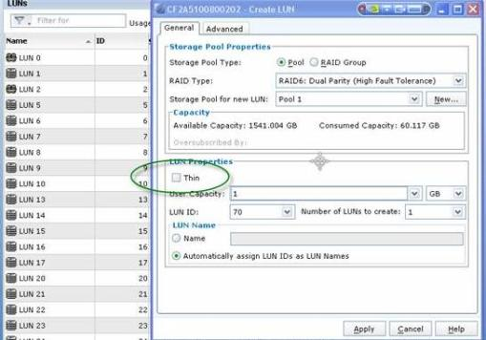
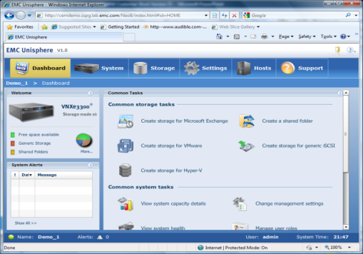
VNX Virtual Provisioning
Thick pool LUN
Full capacity allocation
Near RAID-Group LUN performance
Capacity reserved at LUN creation
1 GB chunks allocated as relative block address is written
Thin pool LUN
Only allocates capacity as data is written by the host
Capacity allocated in 1 GB chunks
8 KB blocks contiguously written within 1 GB
8 KB mapping incurs some performance overhead
EFFICIENCY
Notes:
Let’s look in a bit more detail at how thick and thin LUNs are implemented within virtual pools.
Thick LUNs reserve FULL SPACE at creation, but do not allocate the space immediately, but merely account for the space requirement by the thick LUN. If a LUN is thick the system will guarantee that the capacity is available for that LUN when needed. The physical allocation of capacity happens in 1 GB slices as the application writes to the VNX. Logical block addresses are mapped directly into the respective 1GB chunk so capacity is not used up sequentially within each 1GB chunk but relative to the RBA of the LUN eg if an application is writing sequentially, the 1GB chunks will be filled up sequentially, if the application is writing randomly all over the LUN, the 1GB chunks will be allocated more frequently with each new write. The smallest allocation is a 1 GB contiguous address. Thick LUNs are best for high performance applications and incur little to no performance overhead versus RAID-group LUNs.
Thin LUNs work in a similar way to thick LUNs, except the logical LUN space is not initially reserved within the pool. The Thin LUN is allocated 2 GB at creation and allocates more 1 GB slices as needed. Within each slice, space is mapped in sub-units of 8KB and space within each 1GB chunk is consumed sequentially regardless of whether the incoming writes are sequential or random. In order to map thin LUNs at the 8KB level does incur some overhead and while this option does provide the best TCO it does so with a tradeoff in performance. So it is necessary to ensure that the LUNs that leverage thin provisioning do not need the highest performance requirement.
Thinly provisioned LUNs do introduce a level of risk that when the host application writes to the LUN it always assumes that the space is available to it. For this reason it is important to monitor the system regularly and set alerts when storage pools get close to filling up.

Slide 36





VNX Thin Provisioning
Only allocate the actual capacity required by the application
VNX THIN PROVISIONING
Capacity oversubscription allows intelligent use of resources
File systems
FC and iSCSI LUNs
Logical size greater than physical size
VNX Thin Provisioning safeguards to avoid running out of space
Monitoring and alerting
Automatic and dynamic extension past logical size
Automatic NAS file system extension
FC and iSCSI dynamic LUN extension
User A
10 GB
User B 10 GB
User C 10 GB
Logical
application
and user view
Physical
allocation
4 GB
Physical consumed storage
2 GB
2 GB
Capacity on demand
EFFICIENCY
Notes:
VNX Virtual Provisioning further improves capacity utilization. File systems as well as FC/FCoE/native iSCSI LUNs can be logically sized to required capacities, and physically provisioned with less capacity. This means storage need not sit idly in a file system or LUN until it is used. Provisioning is simplified, and capacity utilization is improved.
VNX Virtual Provisioning safeguards allow users to keep track of thinly provisioned file systems and LUNs. By reporting on actual physical usage, total logical size, and available pooled capacity, administrators can both predict and set alerts to avoid running out of physical capacity.
In addition, with Automatic File System Extension and Dynamic LUN Extension, physical allocation can be increased in real time, as needed.
Note to Presenter: VNX for File has its own thin provisioning capability that operates at the file system level. While it is possible to use block level thin provisioning at the VNX for File LUN level (Thin storage pool LUNs) it is recommended to use File system level thin provisioning and thick pool LUNs, to avoid unnecessary performance overhead.
Note to Presenter: The ability to shrink block LUNs with Windows 2008 R2 hosts was provided with the CLARiiON CX4 platform. This feature is no longer supported with VNX.
VNX for File Automatic File System Extension functionality works with both NFS and CIFS. It automatically extends a file system up to a pre-selected high watermark without Administrator intervention. Automatic File System Extension does not require the Storage Administrator to continually monitor file-system utilization, or to rely on e-mail or pager notification when a file system starts filling up. By extending the file system automatically, it reduces the possibility of a file system running out of space, and makes life easier for the Storage Administrator.
The LUN Extension capability can be used to improve storage utilization, increase efficiencies, and reduce the possibility of errors in provisioning, by dynamically extending the logical size of the LUN on the fly. By dynamically reserving additional blocks for a LUN when required, this feature eliminates the disruption of migrating from one LUN to a larger one when space starts to run out. LUN Extension improves overall service levels and lowers cost of ownership by making operations simpler, and by allowing the Storage Administrator to tune for optimum storage utilization.
Note to Presenter: Dynamic LUN Extension is not an automatic function.

Slide 37
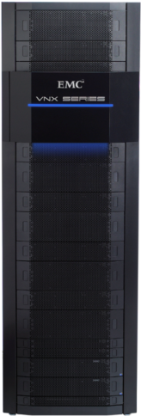





Space Reclamation with Thin
Migrate to Thin Using LUN Migration or SAN Copy
Thickly Provisioned Data
Thinly Provisioned Data Reduced storage capacity
Freed Capacity Returned to pool for usage by other LUNs
Storage Pool
EFFICIENCY
Notes:
We can enable thin provisioning for either Thick pool LUNs or RAID group LUNs.
<CLICK>
The underlying process that effects the conversion is a migration of the thick LUNs into the thin LUN format (this will require movement of data via host transparent LUN migration). As the unused capacity is freed up, those data blocks are returned to the pool.
The data compression feature provides a further reduction of capacity savings initially provided by Virtual Provisioning.
Users can think of it as a progression from fully provisioned data, to thinly provisioned data, to compressed data (even MORE thin!).
This progression further reduces customer TCO by providing maximum storage savings on the LUN, and freeing up that capacity to be used by other LUNs in the pool.
The process can be reversed if necessary and LUNs can be uncompressed and inflated manually as required, which is a seamless process for the applications using the LUNs.

Slide 38

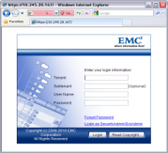


VNX Object Support
A SINGLE CLOUD BUILT WITH VNX SYSTEMS
SOFTWARE ON VMWARE
Certified with EMC Unified Storage (NFS, FC, iSCSI); VMware-supported servers and third-party storage
UNISPHERE GUI
INTEGRATION
REST, SOAP, HTTP or Web access
Object Technology (Atmos/VE)
Atmos Virtual Edition
No limits on namespace or location
Multi-tenancy securely isolates data
Automated location, protection, and efficiency services
NEW
Flexibility
Tokyo
New York
London
VMware vSphere
NFS/FC/iSCSI Storage
Starts at 10 TB
Up to 960 TB per site
HARDWARE
Notes:
VNX Object support is delivered as a fully supported solution that uses the virtualized Atmos VE implementation attached to one or more VNX systems. At a high level, Atmos is…
A new data storage and management framework
Based on a unique set of data services with no limits on namespace or location
Web-based services, multi-tenancy, and automated protection and efficiency services
Layered over an EMC-developed, exabyte-scale object store on physical or virtual appliances
Addressing challenges with storing and managing vast amounts of unstructured content for custom or packaged applications
Atmos can be managed as a single system over many sites and can be delivered as a self-service experience to consumers.
Note to Presenter: REST and SOAP are programming styles and Web Services interfaces for Atmos. REST = Representational State Transfer. SOAP = Simple Object Access Protocol.
Atmos supports both custom and packaged applications through its versatile API. The Atmos REST API allows applications to access Atmos resources no matter whether they are connected locally or remotely over the WAN. This enables the global access described for content-rich applications, but also enables packaged applications to scale into new use cases like remote backup, remote archiving, and other online services.
Atmos provides a very compelling solution in the following use cases:
The first is content-rich web applications. There’s a wide range of applications fitting this profile, whether external-facing applications like a printing service for business cards, an online auction service, or even a web-based messaging application.
The next use case is infrastructure as a service. Think about this as an external service that EMC partners like AT&T deliver, or consider it as a service delivered within your own enterprise to allow internal customers to access and build applications
The final use case is archiving to the cloud, extending an existing on-premises architecture for archiving to an on-premises or off-premises Atmos. Atmos enables customers to consolidate geographically distributed archives into one system, logically isolate them with multi-tenancy, and then protect them efficiently using policy-based management.
For more detail on Atmos, please see the following presentation on PowerLink: http://powerlink.emc.com/km/live1/en_US/Offering_Basics/Presentation/Atmos.pptx

Slide 39
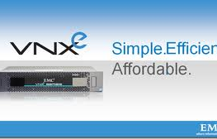
VNXe Introduction
Basic idea of an integrated unified storage
VNXe architecture summary
Storage management in more depth
C4LX in more depth

Slide 40
VNXe – Integrated
Unified Storage
Notes:
Thank you.

Slide 41









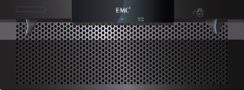

EMC VNXe – Unified Storage
INTEGRATED NAS, iSCSI, (FC, SAS)
Multi-protocol data access
File Protocols: CIFS, NFS
Block Protocols: iSCSI, (FC, SAS)
Managed via a single GUI
Centralized management
One interface to learn, maintain
Enables consolidation of file server and application data
No need for separate file and block devices
Better capacity utilization and scaling
Lower cost of management
Ability to adapt to changing I/O requirements over time
iSCSI SAN
Fibre Channel
NAS
Ethernet
iSCSI SAN
Ethernet
File Sharing
Fibre
Channel
SAN
Single
Management
Interface
SAS
EMC VNXe

Slide 42
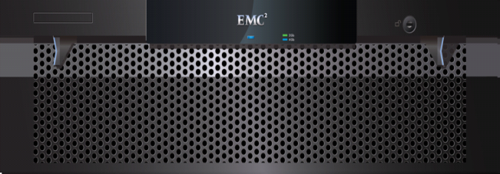
EMC VNXe -- “Simple” Meets “Solid”
Simplified Installation
Setup wizard
High Availability
No single point of failure
Smart Provisioning
Application-centric and simple provisioning
Integrated Data Protection
Data recovery, disaster recovery, and more…
Designed for the IT generalist
+
Advanced features
Smart Management
Centralized and simple GUI
Monitoring and Alerting
Unique value proposition
Flexibility and Scale
File (CIFS, NFS)
Blocks (iSCSI, SAS)
4 - 8 GbE ports -- I/O module scaling
Simplified Support
and Self-help
Integrated access to product ecosystem and online community
Advanced Features
Virtual Provisioning
File-level Retention
Data De-duplication
Storage Tiering
VNXe
Simplicity combined with
enterprise-class features
Notes:
Title
Month Year
42

Slide 43
VNXe Family - Integrated Unified Storage
VNX Family
VNXe Family
…
Control Station
SP A
Multi-core Processors
Data Mover 2
Data Mover 3
Shared Memory Resources
SP A
SP B
DME
DART
C4CB
DART
FLARE
EMC Apps
Cmn Mngmt
C4CB
DART
FLARE
EMC Apps
Cmn Mngmt
Flare
Storage Proc A
Storage Proc B
Flare
SPE
FLARE
Backend disks
SPS
SPS
Backend disks
Notes:
On the left, EMC's currently shipping converged file and block product
Different types of traffic
iSCSI: through DART enclosure to FLARE enclosure
File: through DART enclosure to FLARE enclosure
FC: through FLARE enclosure
Control station: yet another enclosure required for the DP to operate
Two SPSs: additional HW for the data path
On the right, a C4/N1 view of the world
Control Station HW eliminated by becoming co-resident with FLARE and DART
SPS HW eliminated by a vault-to-flash strategy
Separate FLARE and DART enclosures replaced by one enclosure that accepts ALL protocol flows
The data path in this picture has been collapsed to run together. For details on how this was accomplished I'd like to introduce Matt Yellen

Slide 44
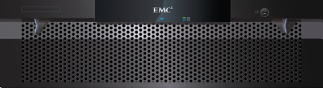

VNXe Product Family – Platform Comparison
 | NX3e (NeoA) | VNXe 3100 | VNXe 3300
Physical Description
Form Factor | 6U, 15 Drive | 2U, 12 Drive | 3U, 15 Drive
Placement | Rack mount | Rack mount | Rack mount
Disk Options | 3.5” FC, SATA | 3.5” SAS, SATA | 3.5” SAS, SATA, EFD
 |  | 2.5” SAS, SATA | 2.5” SAS, SATA
Processing Capacity
Storage Processors (SP) | Dual SP x Quad Core | Dual SP* x Dual Core | Dual SP x Quad Core
Memory per SP | 8 GB | 4GB → 8GB | 12GB → 24GB
Connectivity per SP
Host IP Connect | 4 x 1GbE | 2 x 1GbE | 4 x 1GbE
Backend | 4Gb FC | 6Gb SAS | 6Gb SAS
Scalability
Disks | Up to 30 | Up to 96 (3.5”) | Up to 120 (3.5”)
Initiators | 40 | 256 | 256
Port Expansion | 1 SLIC per SP | 1 eSLIC per SP | 2 SLICs per SP
Port Options per SLIC | 4 x 1GbE | 4 x 1GbE | 4 x 1GbE
 |  | 2 x 10GbE | 2 x 10GbE
 |  | 4 x (4 x 6Gb) SAS | 4 x (4 x 6Gb) SAS
 |  | 4 x 8Gb FC | 4 x 8Gb FC
 |  |  | 2 x 10GbE FCoE
*Single SP configurations supported via cache memory canister (eHornet)

Slide 45
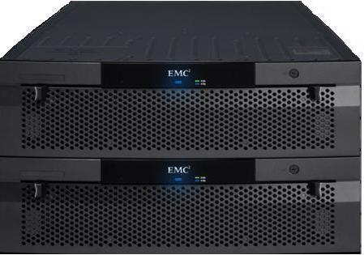
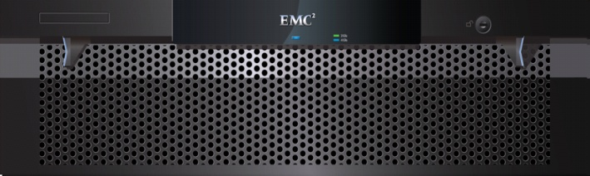
High Availability
Platform
No single point of failure
n + 1 power and battery backup
Redundant, hot-pluggable components
Function
RAID protection
Active/Active controllers
Data cache mirroring between controllers
Battery-backed cache for single SP configs
Dynamic failover/failback
Automatic management control failover
Vault-to-Flash technology
Service
Non-disruptive upgrades
Hot-swap CRU and drive replacement
Remote maintenance, call-home, automatic diagnostics
EMC VNXe

Slide 46



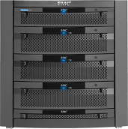

Networking Interoperability
Network interfaces
Gigabit Ethernet
10 Gigabit Ethernet
(FCoE)
Network protocols
IPv4, IPv6
TCP/IP, UDP/IP
CIFS (SMB1 and SMB2), NFS 2, 3, and 4
FTP, TFTP, and SNMP
NDMP 2, 3, and 4
NTP, SNTP
iSCSI target
Feature support
Link aggregation
(FailSafe Networking)
Ethernet trunking
VLAN Tagging
SNMP
(FSN)
Ethernet
TCP
iSCSI
Gigabit Ethernet
NFS
VLAN
Trunking
CIFS
FTP
NDMP

Slide 47
Neo Feature Summary
Networkworking & Protocols
IP V4, IP V6
Jumbo frame support
Link aggregation
NTP/SNTP
Auto-negotiated connection speeds
CIFS (SMB2)
NFS V4
FTP/Secure FTP
Active directory
LDAP
Advanced Features
Virtual provisioning
File-level retention
Drive spindown
Automated Storage Tiering (FAST)
File-level de-duplication with compression
Block-level de-duplication with compression
Embedded Recoverpoint replication appliance
Setup and Installation
Customer installable
Color-coded connections
Preloaded software
Quick start guides for easy setup
Simple, configuration wizards
Helpful “how-to” videos
Application-Aware Management
Web-based element management
Intuitive, task-oriented, graphical user interface (GUI)
Integrated application best practices
Application provisioning wizards
Monitor application storage usage
Graphical identification of failed components
Active links to product ecosystem for self-help and assisted support
Scriptable CLI
Customer defineable application profiles

Slide 48
VNXe竞争优势
Vendor
Model | VNXe3100 VNXe3300 | DS3000 DS3500 | MSA2000G2 P2000G3 | MD3000 MD3200 | FAS2000 | S2600 | ZFS 7100/7300
Manufacture | Not OEM | OEM LSI | OEM Dothill | OEM LSI | Not OEM | Not OEM | Not OEM
Unified | √ | x | x | x | √ | x | √
Combo | 2011H2 | √ | √ | x | √ | √ | √
SSD | 2011H2 | x | x | √ | x | x | √
6Gb SAS | √ | √ | √ | √ | x | x | √
Drives | 96/120 | 96 | 96 | 96 | 136 | 96 | 48/96
Cache | 8GB/24GB | 2GB/4GB | 2GB/4GB | 2GB/4GB | 2/4/8GB | 4/8GB | 24GB/144GB
10GE | √ | x | √ | x | x | x | √
Cache Mirror | √ | √ | √ | √ | √ | √ | x
Thin Provisioning | √ | x | x | x | √ | x | √
Compression | √ | x | x | x | x | x | √
De-du | √ | x | x | x | √ | x | √
VMware integration | √ | x | x | x | √ | x | x
Chinese | √ | x | x | √ | x | √ | x

Slide 49
VNXe Architecture Summary
Notes:
Thank you.

Slide 50
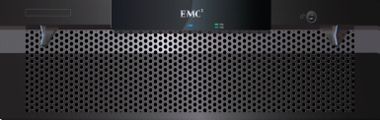
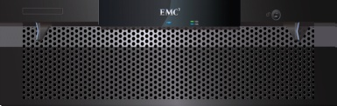






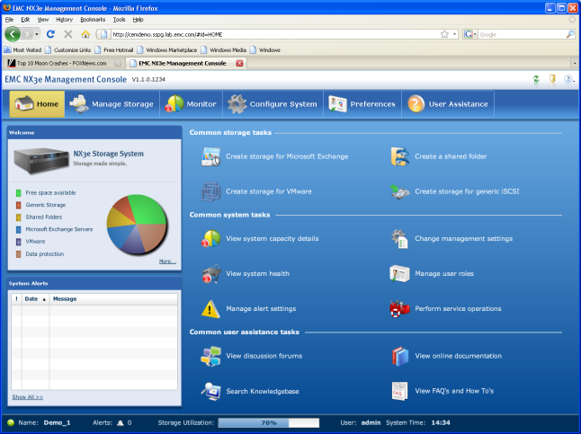


Code Convergence/Next Gen Products
C4 Code Base
VNXe Products
C4CB:
Converged S/W Assets
C
O
M
P
O
N
E
N
T
S
Management & Apps
Protocols
UniSphere
for VNXe
Data Services
Array S/W
OS Independence
OS Layers

Slide 51
C4 Code Base – Producer/Consumer Model
Uni Sphere
CLARiiON
EMC Standards
Ease of Everything
Common Look & Feel
C4CB
Converged S/W Assets
Celerra
Centera
Data Services
Dart & FLARE
Containers
Integration & Perf.
C
O
M
P
O
N
E
N
T
S
Management & Apps
RMSG/ECOM…
Protocols
RSA/CST
CSX
Data Services
Portability
O.S. Independence
ESD AD
SSG
Array S/W
Platform Services
EMC H/W
Common Services
ISC
40+ patents filed
Active/Active
Platform Services
Ease of Everything
Application Orientation
Best Practice Automation
…..
OS Independence
OS Layers
C4LX
Open O.S.
O.S. Services

Slide 52
C4LX High-level Diagram
Multiple Containers/Data Services
…
Single Instance C4LX Services
Single Instance Linux Services
CP Services
C4LX Linux (Open Source) Services
CP Provider
Data Path/Control Path/Application Logic
C4LX Platform Core Services
C4LX Platform Container-resident services
Any/All optional
CSX
Linux Runtimes and Services
U
K
C4LX Kernel-Resident Services, Shims
Kernel-Resident Data Path Logic
Linux Kernel, Data Path, Networking
CSX
Linux Device Drivers
Physical or virtual devices
Physical or virtual CPU & memory
Notes:
Title
Month Year
52

Slide 53

VNXe Components
Element Manager (UniSphere)
EMC standards
ECOM, ECUE, ECUIT etc
Extreme Easy to use GUI
NAS + FileSystem (C4DP-Dart)
EMC Field Proven (Celerra)
Dart journal filesystem
Thin Provisioning, Thin Snaps etc
Disk Protection (C4DP-Flare)
EMC Field Proven (Clariion)
Flare RAID, Mirror-Write-Cache
OS Independence (CSX)
Platform (C4LX, C4LX-PS)
EMC standards
CST, CLT, ELM etc
SuSE 64bit Linux
EMC Field Proven Dual-Node hardware
Flash/SSD, 64bit, Multi-Core
Block & File Services
C4
CEM
Dart
C4
Dart
C4
Flare
CSX
C4LX
SSD
EMC H/W
…
Integrated And Converged
H/W & S/W

Slide 54
Storage Management in More Depth
Notes:
Thank you.

Slide 55

UniSphere Product Vision
Simplified and converged management of storage elements
Intuitive, automated and adaptive workflows enforce best practices and SLA policies
Enable delegation of storage management tasks
Federated storage system management
Application awareness
Secure and scalable
Architected for cooperative development within EMC and with our partners
Leverages fewer code paths for improved quality
Enable self service and web based services
Built to EMC and Industry standards
Need a graphic here!
UniSphere makes the easy things trivial and the hard things easy
Notes:
Title
Month Year
55
Title
Month Year
55
The UniSphere Management interface, enables simplified and converged management of block, file and data services by abstracting the storage constructs and presenting storage allocation based on best practices and SLA policies.
Intuitive, automated and adaptive workflows targeting management for IT generalists as well as storage experts.
Storage management delegation enabling end users and applications administrators to manage storage in a safe manner.
Federated storage system management for large diverse enterprise environments
The UEM product architectural design and ecosystem would be leveraged within EMC as a common asset to ensure product quality, reduction of product development costs and the rapid deployment of valued added functionality.
Provide a single sharable management construct for a each storage function
Admin to presentation layer
Architecture and coding practices
Entry points for external applications
Conform to applicable EMC and industry standards eg ECUE, ECOM, SMI-S, etc

Slide 56
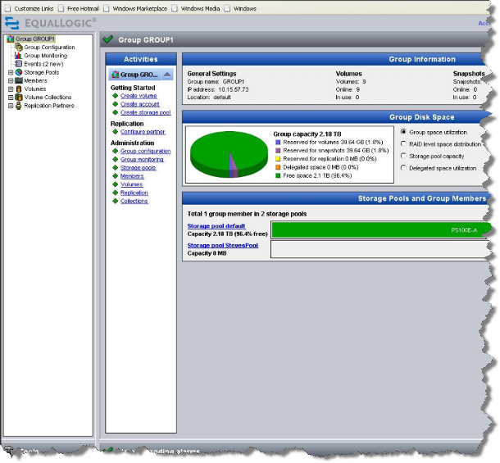
The Storage Management Challenge
Not designed for IT generalist
Assume knowledge of storage terminology
Navigation is based on storage concepts not management tasks
No association between an application and its storage
Users are focused on managing their applications
They want to monitor and manage how their applications are using storage
Provisioning storage requires the user to research and learn best practices for each application
Not clear where to go for information or support
It’s difficult to manage storage in the context of the application
Requires understanding of storage terminology
Navigation is based on storage concepts not management tasks
GROUPS
STORAGE POOLS
MEMBERS
VOLUMES
VOLUME COLLECTIONS
REPLICATION PARTNERS
LUNS
RAID SETS
META VOLUMES
Notes:
We dropped the creating volumes bullet, to specific

Slide 57
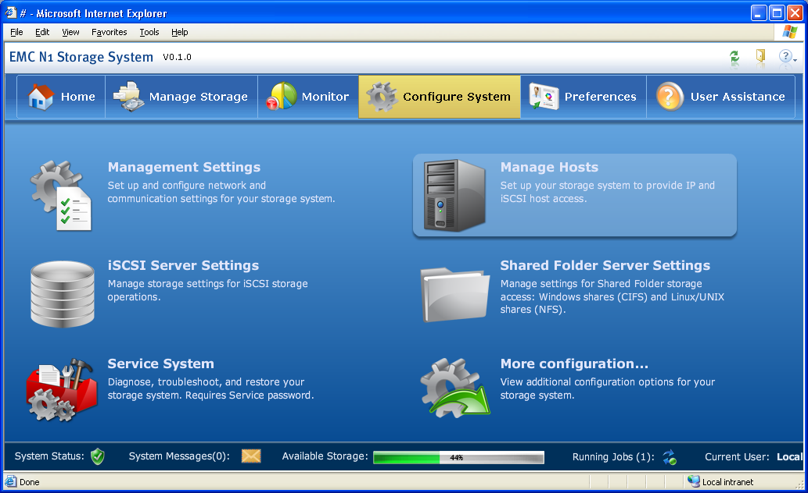
VNXe Simplified Storage Management
Graphical, task-oriented model
Approachable, intuitive design
“Web-familiar” look & feel
Simplifies management for the storage novice
No storage background required
Immediate productivity
Users can easily:
Create storage for an application
Monitor and manage that application’s storage
Customize the interface according to personal preferences or local language requirements.
Challenge
VNXe Storage Management
Graphical User Interface
Notes:
Title
Month Year
57
We dropped the creating volumes bullet, to specific

Slide 58
ECOM/OSL# and C4 CEM Architecture
GUI
CLI
HTTP
BAM-XML
HTTP
BAM-XML
ECOM
Management
Server
Web Server
Dynamic
web content
UI Services
OSL#
UI Application
Service
OSL#
Other services…
OSL#
Application
Provisioning Service
OSL#
Storage Pool
Provisioning Service
OSL#
Best Practice
Service
OSL#
Data Protection
Mgmt Service
OSL#
Core CLARiiON
Service
OSL#
CIM NAS
Service
OSL#
Persistence
Service
…
Adapter
Adapter
Adapter
…
Flare
Dart
PSM Feature
…
Notes:
ECOM / OSL#
ECOM as CIM, application and web server
OSL# as provider plug-in interface
Providers
Many providers, different purposes: infrastructure, storage services, UI services
Consume each other, same ECOM and across ECOMs
Typical pattern: adapter, service in provider, abstraction

Slide 59
VNXe – Scriptable CLI
CLI
Configuration
Server creation / modification
DNS configuration
NTP configuration
SMTP configuration
Alert configuration
User management
Host management
Provisioning
LUN provisioning
Custom application management
Replication configuration
Dedupe configuration
Snap management
Replication management
Host management
Monitoring
Health monitoring
Performance reporting
Capacity reporting
Logs
Alerts
Maintenance
License file management
Software updates
Configuration retrieval
Data Collection initiation / download
Configure additional storage
EMC CONFIDENTIAL
Notes:
Title
Month Year
59

Slide 60
C4LX in more depth
Notes:
Thank you.

Slide 61
C4 LX Service Container Options
0-n instances
0-n instances
0-n instances
0-n instances
(VM)
Framework Can combine Internal and external SW Assets
Four primary ways to insert SW
Multiple instances of SW Fault zones are supported
Architecture convergence can only occur in Internal EMC SW space
A commonality infrastructure is required
CSE and URT are the infrastructures
The Framework allows service access between all isolated fault zones
Internal
SPO
Data Path
IP
Internal
EMC
Apps
External
Apps
External
Apps
Isolated
Fault
Zones
CSX
URT
Syscall
OS
Linux (64 bit)
CSX
Native APIs
Hypervisor
VSwitch
HAL
FC Driver
Ethernet Driver
Other Drivers
HW Platform

Slide 62
Current C4LX SW Stack Block Diagram

Slide 63
C4LX Vertical Features Diagram
EMC Backend Infrastructures
License backend
ECO
SYR
UniSphere
Provider
Provider
Provider
Provider
Prov
Prov
Licensing
Logging
Auth.
Platform-API
Platform-API
Flare
Dart
Env Control
ConnectEMC
FlexLM
CST
CST
CSX
CSX
HA
Linux Kernel / OS
CSPO Hardware / BIOS-POST

Slide 64
C4 Data path
Upstart and
Startup
Scripts
DB
DB
DB
DB
CSX_ICM.pm
name=“csx_helper”
Name=“cdxic1”
Name=“ccsx”
Name=“gms_svr_ic
IC CLI
Name=“cdxic2”
TCD
CDX
GMS
Server
Name to
ID DB
To all containers
Fiber Drivers
Display CLI
DB
Output
User
Kernel
FC HBAs
name=“csx_kernel”
CMI Hardware
DMA
CMI
CSX Kernel IC
csx_display
Linux Kernel
Network/Block
Stack
VNIC
Block Shim
GRMAN
csx_pshim
Legend
csx_llk
Hardware or OS
Kernel Module
CSX Container
CSX Module
Notes:
DMA – interface to Intel DMA Chip for dual-SP communication
Ported from CX into a CSX module
CMI – lower half of CMI user space driver for dual-SP communication
interfaces with “bridge” chip HW. Ported from CX into a CSX module
VNIC – kernel infrastructure above modified LINUX network driver.
Wholly SSPG owned and consumed
Block Shim – kernel portion of block shim that vectors I/O up to FLARE
csx_ic_k – the main “kernel” container for CSX
csx_display – an engineering debug / output manager for CSX
csx_pshim – generic PCI device driver, plug-and-play, presents device ownership
model
csx_llk – low level utilities
CDX – Encapsulation of the Celerra data path into a CSX module. This layer calls
CSX primitives provided by the csx_p.so library
TCD/FLARE – CLARiiON drivers ported into CSX modules.
Windows DDK calls are replaced by CSX primitives provided by
the csx_p.so library
GMS Server - global memory service that distributes memory between containers
GMS interacts with CSX to create a shared memory environment
GMS clients interact with GMS server via CSX primitives
Display CLI – a user space tool that interfaces with the “display” component
in kernel space, routes display output to files
CSX_ICM.pm – Perl APIs to manage containers and modules, uses CSX IC CLI
CSX IC CLI – all user space CSX commands are issued through this CLI. The CLI
communicates with CSX containers in the system via a variety of methods
including network commands and device ioctls.
CSX helper – the CSX helper executes commands on behalf of the csx_ic_k,
handles operations only possible in user space (e.g. load kernel modules)
csx_p.so – user space library that implements the CSX primitives
csx_llu.so – this library insulates the higher level CSX primitives from the O/S
Sleepycat DB – all CSX containers have a persistent “registry” implemented using
a SleepyCat DB
Note, CDX single module
CCSX multiple modules
Single address space request us inter containner communication
VNIC and block shim
Why CMI in kernel, not in Flare container or a common container...guess
Intercontainer communication...
Within modules
Globals, Function calls
Plus all below…
Within container, across modules
Drivers/Devices/DCALLs
Exported/Imported Named Globals
Enables Globals, Function calls
Plus all below…
Across containers
Limited DCALLs to remote devices
Read/Write/IOCTL – with known buffers
Shared Memory
Can host Interlocked Lists
RPCs
Event Queues
Global Mutexes…

Slide 65
Data Path in detail

Slide 66
High availability architecture

Slide 67
Thank you!
Notes:
Thank you.

